Slide 1
Fundraising 102 Making a Case for Support
Michele Neely, President & CEO, State Charter Schools Foundation of Georgia

Slide 2
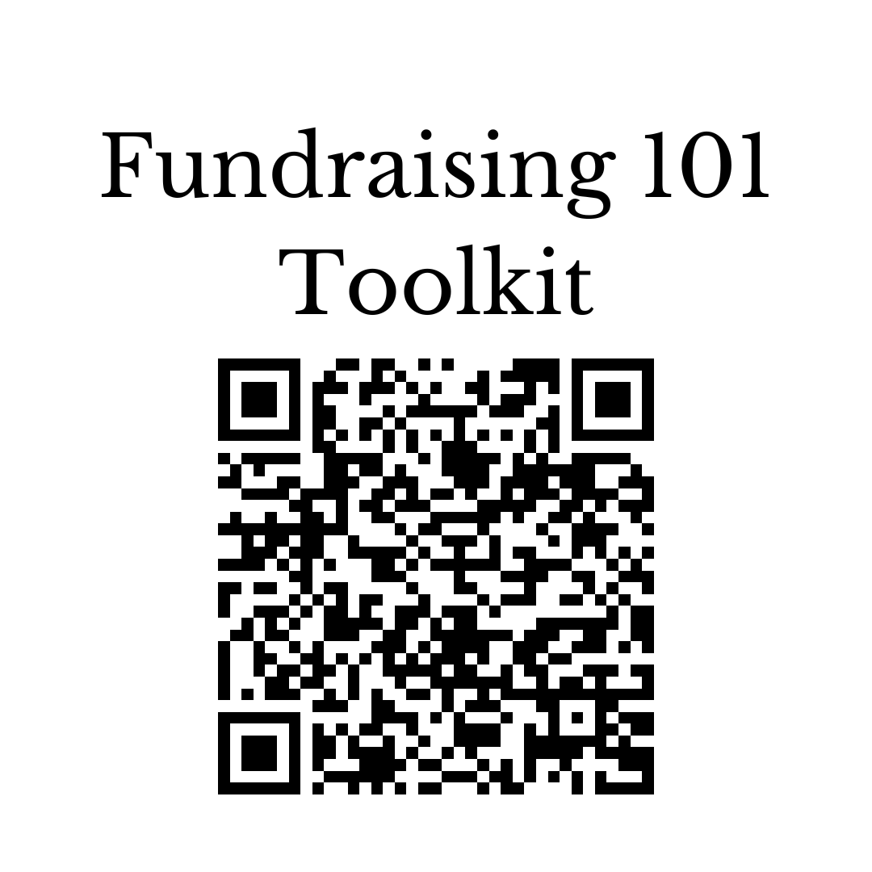
Fundraising Toolkit

Slide 3
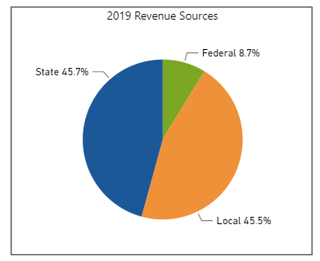
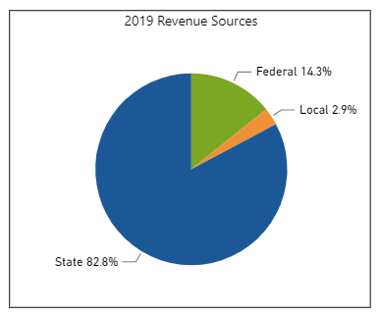
Why You Need to Raise Funds
Make the case for raising funds.
State charter schools:
Only receive funds from the state & federal grants.
Usually have higher operating & facility costs.
Cannot access SPLOST or financing available for traditional school districts
Don’t have access to resources usually shared across districts.
Aggregate for all GA Schools
Typical Title I State Charter School
Charter schools usually receive less government funding overall than traditional public schools while facing higher operational costs.

Slide 4
Strike a Balance
Give the facts – motivate but don’t scare your community.
Set a confident tone: We have a budget/revenue to meet all of our school’s needs. We must have your help to meet all of our school’s wants.
Outline the difference from fundraising at other schools: We are our own school district. So, we need to work together to provide the best educational environment for our students. Fundraising is more essential for our school to offer a unique public education experience. We do not have an endowment or wealthy alumni like a private school.

Slide 5
Your Case for Support
Give donors a reason to give.
Use a “case statement” to articulate to possible funders who you are, why you need support, and what you need support for
Create a shared message for your school & stay focused
May change based on what you need
Include:
Mission & vision
Unique educational focus
Who you serve (ages of students, community, etc.)
Accomplishments & track record
Details about the need

Slide 6
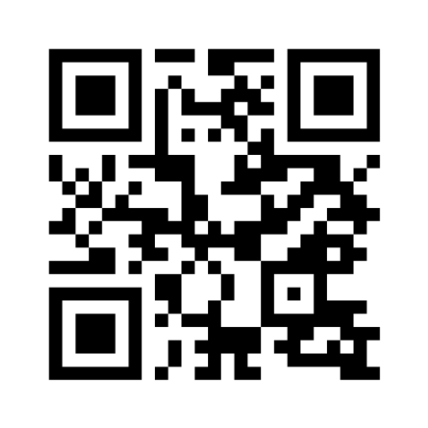
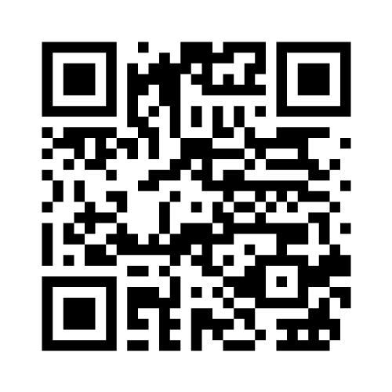
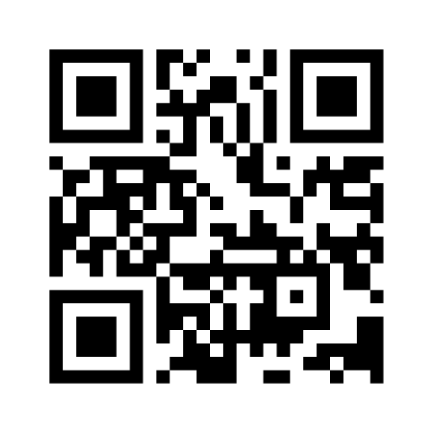
Let’s Take a Look
Do these charter schools “make a case?”
Group 1
Yes Prep
Group 2
Wildflower Schools
Group 3
Signature School

Slide 7
Considering the Case
In your group, look at the school assigned to you.
Can you find the who, what, and why? Write them down.
How does the school tell their story?
How easy was it to find information?
Do they carry the message to social media?
Is there a call to action for supporters?
What questions do you have left about your school?
What was most compelling?
What ideas did this school give you?

Slide 8
Stating Your Case
Pictures tell 1,000 words.
Use clear, concise language – avoid industry terms
Keep a consistent message & theme across all platforms – one voice
Photos, videos, stories strengthen the case
Ask for what you need & give a specific call to action for supporters

Slide 9
Develop Your Case Statement
Work together in your group.
Prepare a 2-minute case to present to the group.
Include your who, what, why
Include a story
Where would you share your case & how?
Pretend you are a donor or foundation. Prepare your feedback on sticky notes.
What was compelling? What stood out?
What questions do you still have?
Other notes

Slide 10
Action Plan
What will you do when you go back to your school?
What ideas did you gain today?
Who/which school impressed you most?
Where are you strong?
Where can you improve?
What next steps will you take?

Slide 11
SCSF Resources
The SCSF is constantly compiling resources for you.
The SCSF maintains a list of grants for schools.
Email info@scsfga.org to receive the Friday newsletter.
Contact Michele if you would like one-on-one consultation on fundraising activities.

Slide 12
We are here for state charter schools!
scsfga.org
@SCSFofGA
Michele Neely, President & CEO – mneely@scsfga.org

