Slide 1
Financing & Budget for State Charter Schools
Carmen Hernández-Freemire
Director Budget Services
470-254-6762 ph | 470-254-1240 fax
FreemireC@fultonschools.org

Slide 2



We’re Here to Talk about a Dirty Word

Slide 3

We’re going to talk about MONEY

Slide 4

State Revenues

Slide 5
Glossary
Full-time Equivalent (FTE) – a student count consisting of six state funded segments per student authorized under O.C.G.A. § 20-2-161.
GADOE- refers to the Georgia Department of Education.
Official Code of Georgia Annotated- O.C.G.A. is the compendium of all laws in the U.S. state of Georgia. Like other U.S. state codes, its legal interpretation is subject to the United States Constitution, the United States Code, the Code of Federal Regulations, and the state's constitution.
Quality Basic Education Formula (QBE) –the State of Georgia funding formula used for determining the amount of state education funds a school district earns annually as described in O.C.G.A. § 20-2-161.

Slide 6
Overview of FY16 State Revenues

Slide 7
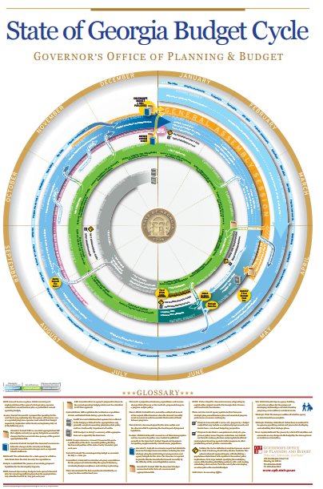
The State Budget Process
Source
https://opb.georgia.gov/sites/opb.georgia.gov/files/imported/vgn/images/portal/cit_1210/44/31/162982494ga_budget_cycle.pdf

Slide 8
The State Budget Process
Annually in January, the Georgia General Assembly convenes.
Each year, the General Assembly passes and the Governor signs two separate budgets.
  The first is to amend the state’s budget for the current fiscal year. This budget makes adjustments for changes in school enrollment and for other unanticipated needs that may have arise during the current fiscal year.
  The second budget is for the upcoming fiscal year.
The state’s fiscal year begins on July 1 and ends on June 30.

Slide 9
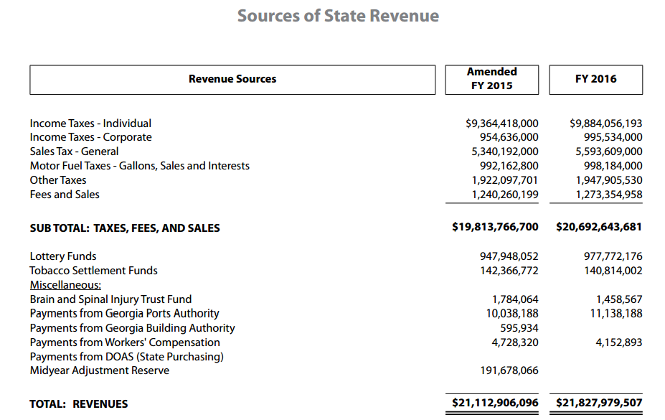
State Revenues
*Source Governor’s Office of Planning & Budget AFY15 & FY16 Budget in Brief, page 20 https://opb.georgia.gov/sites/opb.georgia.gov/files/related_files/site_page/State%20of%20Georgia%20BIB%20AFY%202015-FY%202016.FinalUPDATED08282015.pdf

Slide 10
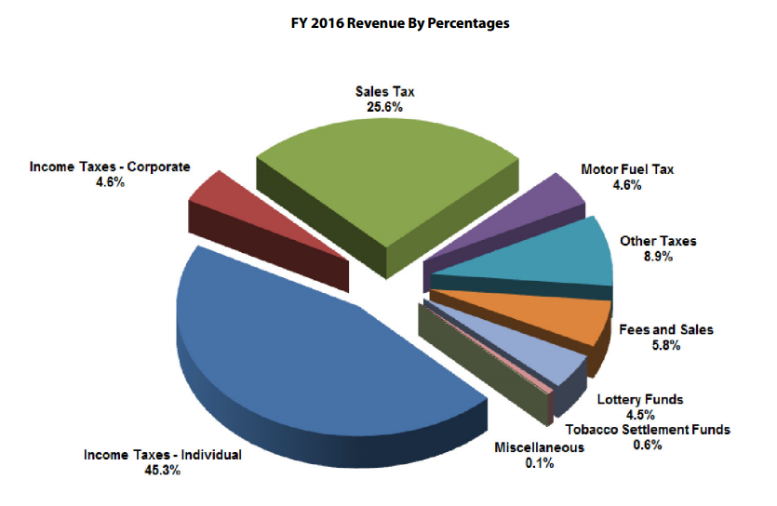
State Revenues
*Source Governor’s Office of Planning & Budget AFY15 & FY16 Budget in Brief , page 20 https://opb.georgia.gov/sites/opb.georgia.gov/files/related_files/site_page/State%20of%20Georgia%20BIB%20AFY%202015-FY%202016.FinalUPDATED08282015.pdf

Slide 11
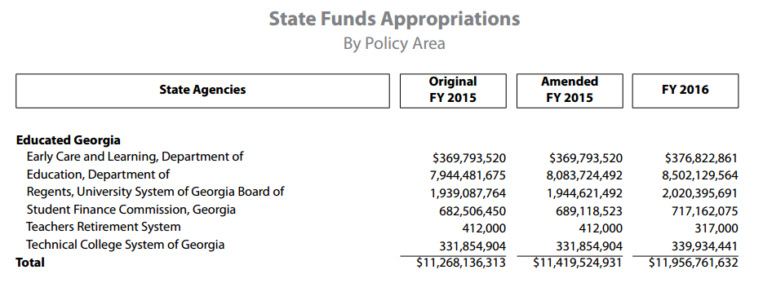
State Revenues
*Source Governor’s Office of Planning & Budget AFY15 & FY16 Budget in Brief , page 28 https://opb.georgia.gov/sites/opb.georgia.gov/files/related_files/site_page/State%20of%20Georgia%20BIB%20AFY%202015-FY%202016.FinalUPDATED08282015.pdf

Slide 12
Numbers
1.7 million – approximate number of children in the K-12 public school system in Georgia.
*Source Georgia Budget & Policy Institute, Georgia Budget Primer , page 2 http://gbpi.org/wp-content/uploads/2015/08/Georgia-Budget-Primer-2016.pdf

Slide 13
Numbers
26,061– approximate number of children in the K-12 public school system educated in State Charter Schools in Georgia for the 2015 – 2016 school year.

Slide 14
Numbers
8,217,829,548- FY16 amount allotted to the Georgia Department of Education for QBE.

Slide 15
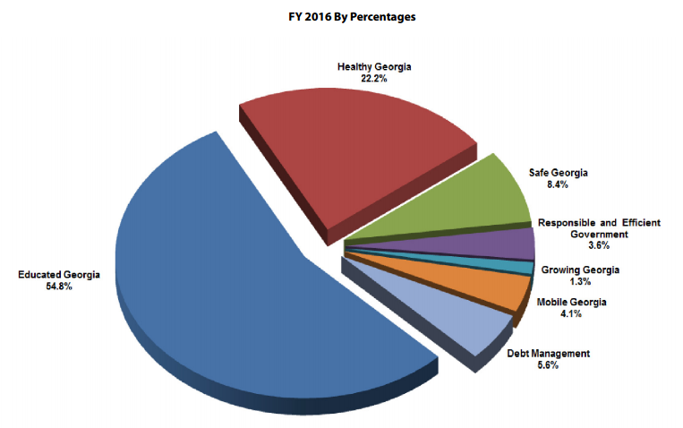
State Allotments by Priorities
*Source Governor’s Office of Planning & Budget AFY15 & FY16 Budget in Brief , page 29 https://opb.georgia.gov/sites/opb.georgia.gov/files/related_files/site_page/State%20of%20Georgia%20BIB%20AFY%202015-FY%202016.FinalUPDATED08282015.pdf

Slide 16
State Allotments
*Source Governor’s Office of Planning & Budget AFY15 & FY16 Budget in Brief , page 29 https://opb.georgia.gov/sites/opb.georgia.gov/files/related_files/site_page/State%20of%20Georgia%20BIB%20AFY%202015-FY%202016.FinalUPDATED08282015.pdf

Slide 17
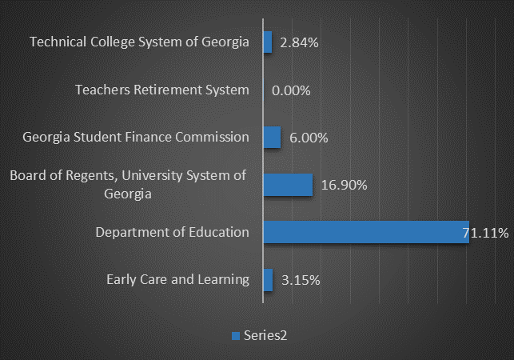
Breakout of an Educated Georgia
*Source Governor’s Office of Planning & Budget AFY15 & FY16 Budget in Brief , page 29 https://opb.georgia.gov/sites/opb.georgia.gov/files/related_files/site_page/State%20of%20Georgia%20BIB%20AFY%202015-FY%202016.FinalUPDATED08282015.pdf

Slide 18
QBE Now &
The Possible Future

Slide 19
Quality Basic Education (QBE)
QBE- Now
The Quality Basic Education (QBE) Act was enacted into law by the 1985 session of the Georgia General Assembly.
The QBE Act set out the provisions for educational funding for grades kindergarten through twelve.

Slide 20
Quality Basic Education (QBE)
The QBE-based state charter school funding is authorized in O.C.G.A. § 20-2-2068.1.
The FY16 appropriation in QBE for state charter schools was $65,797,180, which included $36,788,763 for state virtual charters and $29,008,417 for state brick and mortar charters.

Slide 21
Quality Basic Education (QBE)
QBE- Now
Georgia utilizes a state funding formula that is based on the full-time equivalent (FTE) student counts in eighteen instructional programs to calculate QBE.
Cost components are identified for each program.
Programs are weighted to reflect estimated costs associated with each program.

Slide 22
Quality Basic Education (QBE)
QBE- Now
Six of these programs are for Exceptional Education students (Mild Resource, Moderate Resource, Moderate Self-Contained, Severe Self-Contained, Inclusion, and Gifted).
Twelve of the 18 QBE programs are for students in regular education: K, K EIP, Gr 1-3, Gr 1-3 EIP, Gr 4-5, Gr 4-5 EIP, Middle School, Gr 9-12, Vocational Labs, Remedial, Alt Ed, and ESOL.

Slide 23
Quality Basic Education (QBE)
Accurate FTE reporting is critical to receiving correct funding through QBE.

Slide 24
Quality Basic Education (QBE)
QBE allotments for State Charter Schools are calculated using the same allocation method as all other school districts in the state.

Slide 25
Quality Basic Education (QBE)
Current Program Weights & Funding
Cuer

Slide 26
Quality Basic Education (QBE)
Teacher Student Ratio

Slide 27
Quality Basic Education (QBE)
QBE- Now
Direct Instructional Costs
Salaries and benefits for Teachers, paraprofessionals (Kindergarten only), Subject Specialist (Art, Music, Physical Education, Foreign Language), Counselors, Technology Specialists, and Operations.
Consumable Materials, Textbooks, Travel, Classroom Technology, and Equipment Replacement.

Slide 28
Quality Basic Education (QBE)
QBE- Now, Indirect Instructional Costs
Central Administration
  Psychologists
  Social Workers
  Special Education Leaderships
School Administration
Assistant Principal
Secretary
Operations
Facility Maintenance and Operations
Media (Personnel & Materials)
20 Additional Days of Instruction

Slide 29
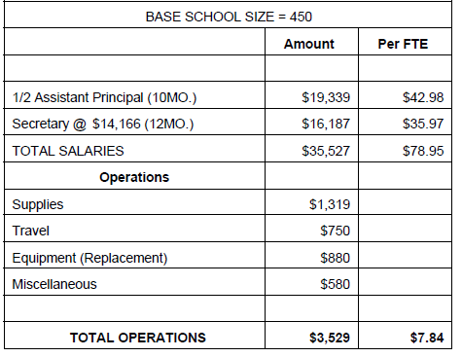
Quality Basic Education (QBE)
QBE- Now
Elementary School Earnings

Slide 30
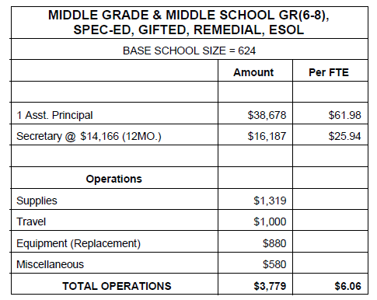
Quality Basic Education (QBE)
QBE- Now
Middle School Earnings

Slide 31
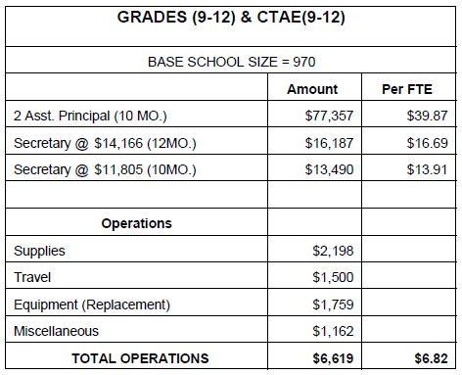
Quality Basic Education (QBE)
QBE- Now
High School Earnings

Slide 32
Quality Basic Education (QBE)
QBE- The Possible Future
In early 2016, Governor Nathan Deal named 34 individuals to serve on the Education Reform Commission which he announced in his State of the State address.
The commission was tasked with studying the state’s education system, including its funding formula, and provide recommendations intended to improve the system, increase access to early learning programs, recruit and retain high-quality instructors and expand school options for Georgia’s families.

Slide 33
Quality Basic Education (QBE)
QBE- The Possible Future
Education Reform Commission website:
http://gov.georgia.gov/education-reform-commission

Slide 34
Quality Basic Education (QBE)
Education Reform Subcommittees
  Funding committee (most closely watched)
  Early childhood education committee
  Move on When Ready committee
  Educational Options committee
  Teacher Recruitment, Retention and Compensation committee
The Commission met as a whole and in its subcommittees throughout the year.

Slide 35
Quality Basic Education (QBE)
Recommendations from all subcommittees will be made to Governor Deal on December 15, 2015.

Slide 36
Quality Basic Education (QBE)
QBE- The Possible Future
Funding Committee Draft Recommendations
The proposal is for the development of a student-based funding formula that consists of three components:
Student Base Funding
Weighted Student Characteristics
Categorical Grants
*Source Education Reform Commission Funding Model Narrative Draft (11-10-15) https://gov.georgia.gov/materials-1

Slide 37
Quality Basic Education (QBE)
QBE- The Possible Future
Funding Committee Draft Recommendations
The proposed formula includes a major shift from the method used in the current QBE formula for how students are counted for funding purposes.

Slide 38
Quality Basic Education (QBE)
QBE- The Possible Future
Funding Committee Draft Recommendations
Instead of funding full time equivalent counts based on six instructional segments, the proposed formula will use student enrollment counts for funding purposes.
The proposed formula does not impose scheduling controls on school districts in order to earn funds.

Slide 39
Quality Basic Education (QBE)
QBE- The Possible Future
Funding Committee Draft Recommendations
The draft formula recognizes that students can have multiple characteristics and will earn money based on each identifiable characteristic.
A school district will earn funding based on the characteristics of the students enrolled and may use the money flexibly to meet the needs of the students.

Slide 40
Quality Basic Education (QBE)
QBE- The Possible Future
Funding Committee Draft Recommendations
The draft funding formula has a new categorical weight for economically disadvantaged students.

Slide 41
Quality Basic Education (QBE)
QBE- The Possible Future
Funding Committee Draft Recommendations
Due to the changes in qualification requirements for the free and reduced price meals program, the recommendation of the funding committee is to use Direct Certification (which includes SNAP and TANF enrollment, homeless students, foster students, and migrant students) as the identifier for this characteristic.

Slide 42
Quality Basic Education (QBE)
QBE- The Possible Future
Funding Committee Draft Recommendations
The draft funding formula has a new method for funding students with disabilities.

Slide 43
Quality Basic Education (QBE)
QBE- The Possible Future
Funding Committee Draft Recommendations
Weights for funding of students with disabilities would be based on the number of minutes a student is served during a week, instead of identification of primary disability which is currently how students with disabilities are funded in the QBE formula.

Slide 44
Quality Basic Education (QBE)
QBE Future- Proposed Weights

Slide 45
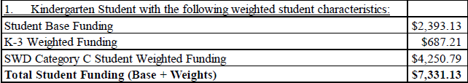
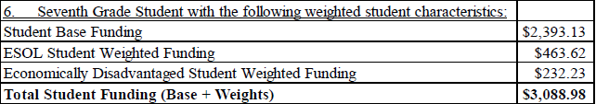
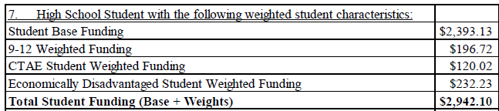
Quality Basic Education (QBE)
Samples of Student Earnings under Proposed QBE Formula

Slide 46
Quality Basic Education (QBE)
QBE- The Possible Future
Next Steps
Draft legislation will be introduced for the 2016 legislative Session.
The House of Representatives and The Senate will review the recommendations and most likely make their own changes.

Slide 47
Quality Basic Education (QBE)
QBE- The Possible Future
Next Steps
Typically, discrepancies between the House and Senate versions of a bill lead to the convening of a conference committee made up of members from both chambers. This committee comes up with a compromise proposal to be voted on by both the House and Senate.

Slide 48
Quality Basic Education (QBE)
QBE- The Possible Future
Next Steps
Once the same bill has passed both chambers, it is sent to the Governor, who then has 40 days to sign the legislation before it automatically passes into law.
If QBE changes are passed, the new formula calculations would apply to FY 2018 for the 2017 – 2018 school year.

Slide 49
State Charter School Supplement

Slide 50
State Charter School Supplement
In addition to QBE formula earnings, state charter schools receive a supplement to partially offset the absence of local tax revenue flowing to state charter schools.

Slide 51
State Charter School Supplement
The FY16 appropriation for the State Charter School Supplement was $65,797,180, which included $36,788,763 for state virtual charters and $29,008,417 for state brick and mortar charters.

Slide 52
State Charter School Supplement
Accurate FTE reporting is critical to receiving correct funding through the State Charter School Supplement.
This applies to both virtual and bricks and mortar charter schools.

Slide 53
State Charter School Supplement

Slide 54

State Charter School Supplement
To calculate the State Charter School Supplement a per FTE cost is generated for the Nutrition, Transportation, Equalization and Capital Revenue grants.

Slide 55
State Charter School Supplement
The per FTE cost is multiplied by the number of FTEs in each state charter school for the Transportation and Nutrition grants if the school has a qualifying program to generate an allocation amount.
Virtual state charter schools do not qualify for funding from Transportation and Nutrition grants.

Slide 56
State Charter School Supplement
How per FTE cost is determined for the Transportation grant:
  The per FTE cost for the Transportation grant is calculated using the prior fiscal year’s appropriation for transportation divided by the Georgia Department of Education’s reported FTEs from the prior fiscal year for revenue.

Slide 57
State Charter School Supplement
How per FTE cost is determined for the Nutrition Grant:
  The per FTE cost for the Nutrition grant is calculated using the prior fiscal year’s appropriation for nutrition divided by the Georgia Department of Education’s reported FTEs from the prior fiscal year for revenue.

Slide 58
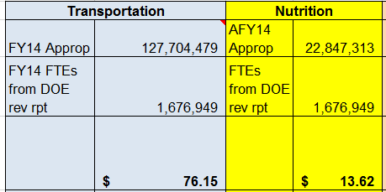
State Charter School Supplement

Slide 59
State Charter School Supplement
What is Equalization?
  Equalization is a grant made to poorer school systems to bring them up to the statewide average per weighted FTE in local wealth.

Slide 60
State Charter School Supplement
The per FTE cost for the Equalization grant is calculated using the average amount of total revenues minus federal and state revenues excluding equalization grants per FTE for the lowest five school systems ranked by assessed valuation per weighted FTE count from the prior fiscal year.

Slide 61
State Charter School Supplement

Slide 62
State Charter School Supplement
The per FTE cost for each grant is multiplied by the number of FTEs in each state charter school for the Equalization grants.
All state charter schools receive funding from the Equalization grant.

Slide 63
State Charter School Supplement
The per FTE cost for the Capital grant is calculated using the state-wide average of total capital revenue per FTE for local school systems from the prior fiscal year to generate a Capital grant for all brick and mortar state charter schools.
Virtual state charter schools do not qualify for funding from the Capital grant.

Slide 64
State Charter School Supplement

Slide 65
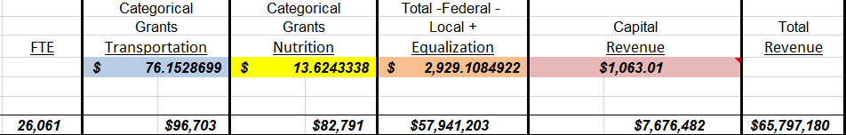
State Charter School Supplement
The amounts from the four categorical grants are totaled to generate the supplement amount for each state charter school.

Slide 66
State Charter School Supplement
The Local Five Mill Share is the amount of QBE and Training and Experience that must be paid for by all the local school systems.
All state charter schools contribute to Local Five Mill Share.

Slide 67
State Charter School Supplement
Since virtual state charter schools receive two-thirds of the calculated state charter schools supplement, therefore, their supplement is offset by two-thirds of the calculated Local Five Mill Share for state charter schools.

Slide 68
Funding Allotments

Slide 69
Funding Allotments
As explained previously, during state legislative session, the Georgia General Assembly passes an adjustment to the budget for the current fiscal year.
Allotment sheets are reissued to include the mid-term adjustment.

Slide 70
Funding Allotments
To find your school’s funding allotment to the GADOE website:
https://app3.doe.k12.ga.us/ows-bin/owa/qbe_reports.public_menu?p_fy=2000

Slide 71


Funding Allotments
Remember to pull your school’s adjusted allotment sheet.
It is important that a school incorporate the mid term adjustment changes into its annual budget.

Slide 72
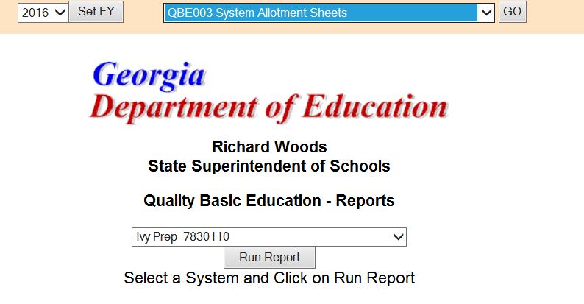
Funding Allotments
Remember to set the fiscal year first

Slide 73
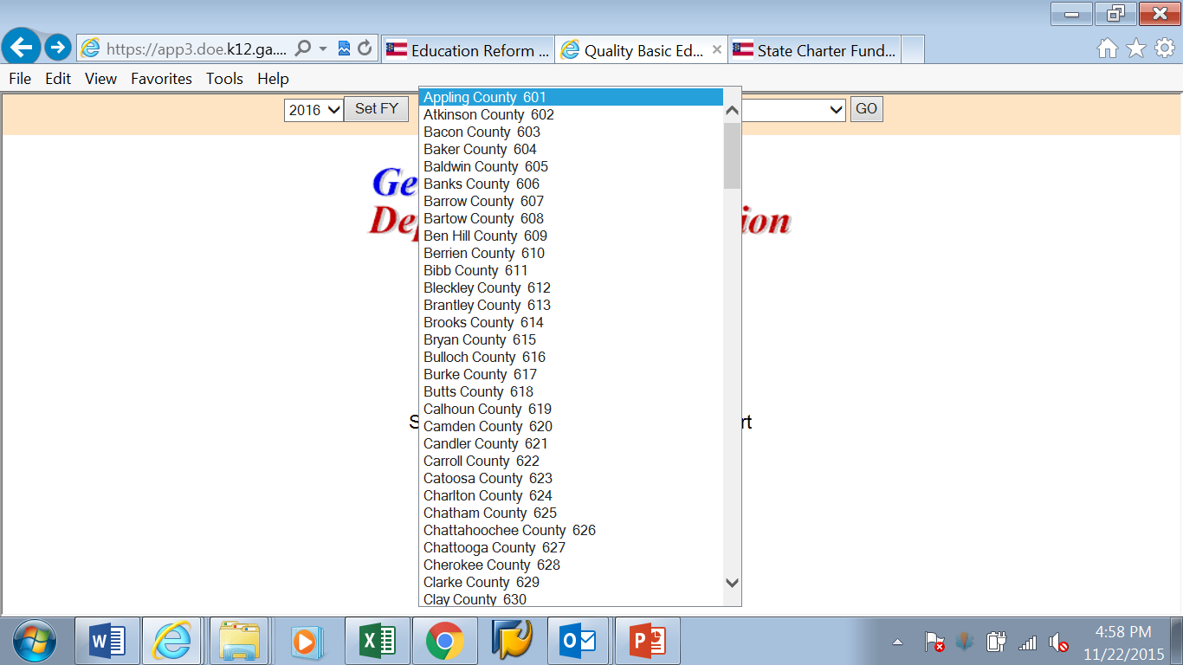
Funding Allotments

Slide 74
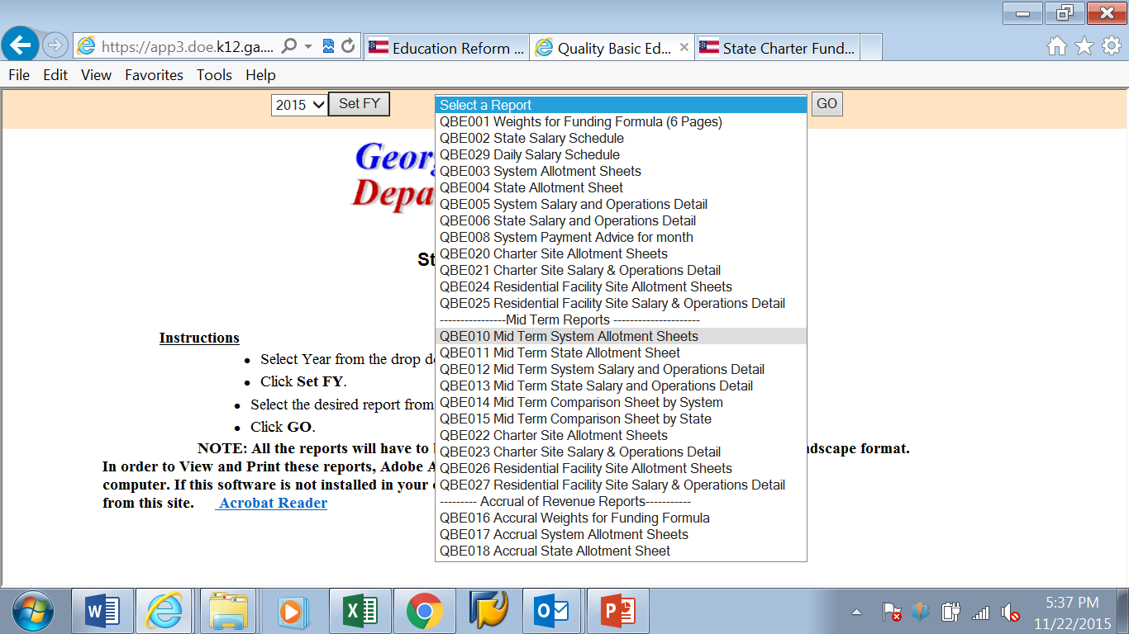
Funding Allotments

Slide 75
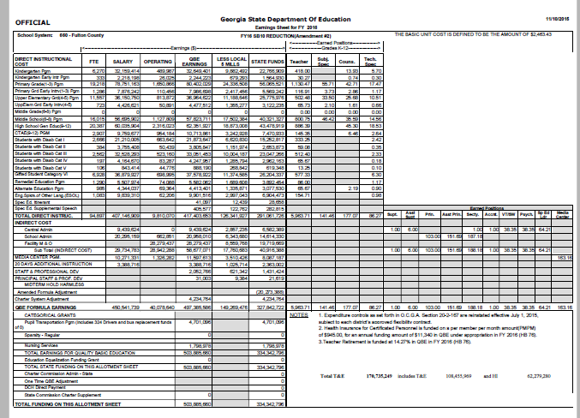
Funding Allotments

Slide 76
Funding Allotments
What information is listed on the allotment sheet?
  QBE Earnings
  Number of FTEs reported
  Earnings for Direct Instruction
  Earnings for Indirect Instruction
  Categorical grants earnings e.g. Nursing, transportation
  Austerity reductions
  Local Five Mill Share

Slide 77
Funding Allotments
Hold Harmless
The mid-term adjustment does not negatively affect QBE funding for school districts.
If a school district’s FTE numbers decrease the QBE allotment remains unchanged.
If a school district’s FTE numbers increase its QBE allotment increases at the mid-term adjustment.

Slide 78
Funding Allotments
Hold Harmless
The State Charter School Supplement is also not adjusted downward if a state charter school’s FTE numbers decrease.
Training & Experience and Health Insurance are also not adjusted downward if a state charter school’s FTE numbers decrease.

Slide 79
Funding Allotments
Hold Harmless
Hold Harmless DOES NOT apply to forward funding.
If your school added a grade(s) or your school is new and enrollment is lower than what was submitted to the Governor’s Office of Planning and Budget during budget development, the school’s funding will be decreased in the amended budget.

Slide 80
State Charter School Supplement
When setting up your school budgets refer to the Local Units of Administration (LUA) information on the GADOE website.
http://www.gadoe.org/Finance-and-Business-Operations/Financial-Review/Pages/LUAS-Manual.aspx

Slide 81
Forward Funding

Slide 82
Forward Funding
New State Charter Schools and those expanding through the addition of a grade level are eligible to receive forward funding per state law § O.C.G.A. 20-2-2089(d).
Funds are received for the following fiscal year which corresponds with the new school year.

Slide 83
Forward Funding
The State Charter School Commission is mandated to report to the Governor’s Office of Planning and Budget (OPB) by July 1 the information for new and expanding state charters schools for incorporation into the Governor’s budget for the upcoming fiscal year.

Slide 84
Forward Funding
These numbers are used by OPB to calculate the additional QBE funding needed in the upcoming fiscal year, so it is critical for schools to submit accurate student information including GTID numbers to the State Charter School Commission by its annual deadline.

Slide 85





Forward Funding
Know the make up of the students in your school!

Slide 86
Forward Funding
Remember projected enrollment funding is not held harmless.
If your school added a grade(s) or your school is new and enrollment is lower than what was submitted to OPB, the school’s funding will be decreased in the amended budget.

Slide 87

Forward Funding
It is important to begin looking at your school’s enrollment and make projections as early as January.
Accurate data collection results in better funding for your school.

Slide 88
The DE46

Slide 89
The DE46
What is the DE46?
  The DE46 is mandated under Georgia Law (O.C.G.A. § 20-2-167) which requires all school districts to report annual budget, financial operating data, and approved annual budgets to the GADOE.
  The DE46 is submitted electronically to GADOE using its portal.
  The GADOE posts transmission date deadlines each year.

Slide 90
The DE46
Why are schools required to complete the DE46?
  The GADOE uses the information reported in the DE46 by schools to complete General Fund QBE Program Expenditure Reports.

Slide 91
The DE46
Final transmission of prior and current fiscal year information for Accounting and Budget Services must be signed off on by the Superintendent and submitted to the GADOE by September 30 of each year.
A school district can request an extension of the deadline. If a district wishes to apply for an extension, it must have a letter, signed by the district’s Superintendent, outlining the reasoning and circumstances for the extension request. The request for the extension is submitted to the attention of the Director of the Financial Review office at GADOE.

Slide 92
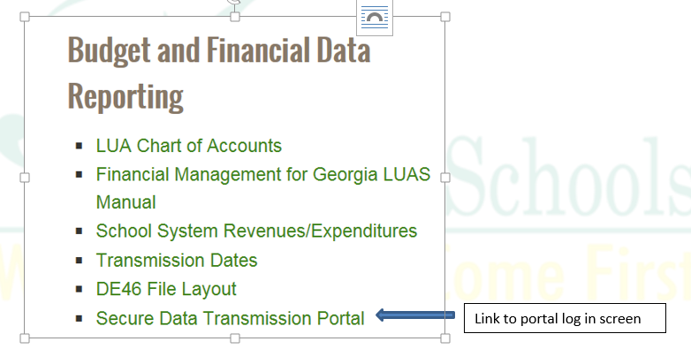
The DE46
http://www.gadoe.org/Finance-and-Business-Operations/Financial-Review/Documents/Transmitting%20the%20DE046.pdf

Slide 93
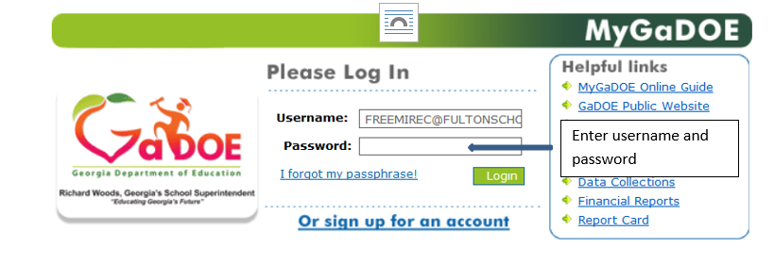
The DE46

Slide 94
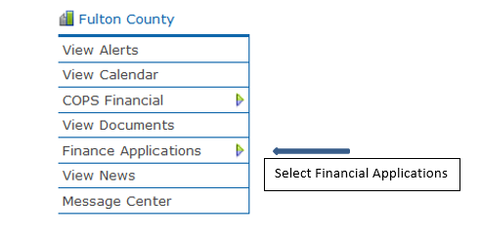
The DE46

Slide 95
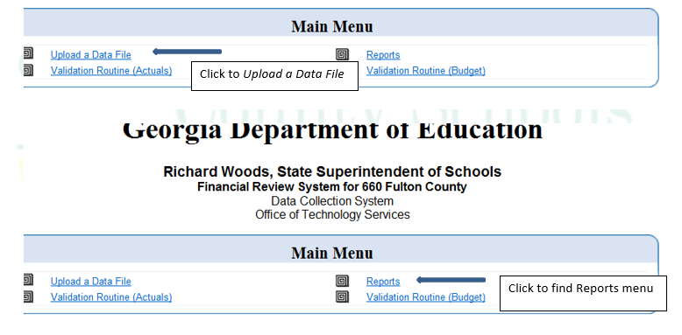
The DE46

Slide 96
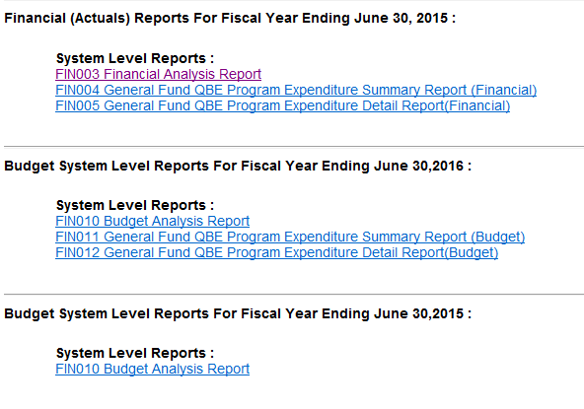
The DE46

Slide 97
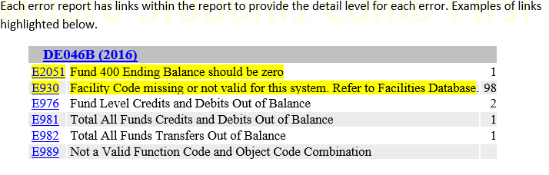
The DE46

Slide 98
The DE46
Errors noted on the GADOE portal for the DE46 must be corrected.
Warnings are not required to be corrected.

Slide 99
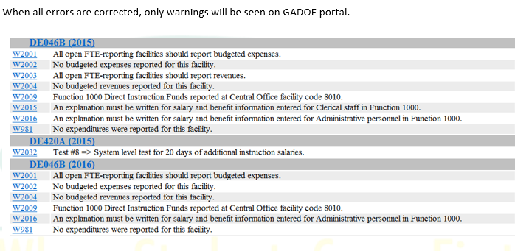
The DE46

Slide 100
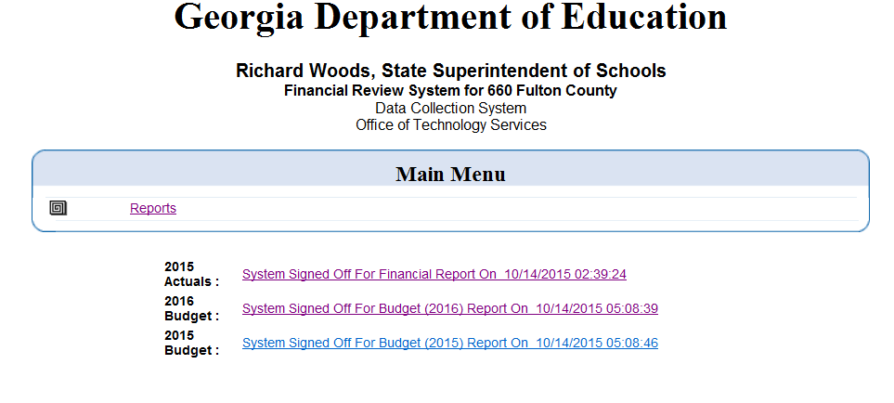
The DE46
Screen shot of DE46 signed off by the School District Superintendent.

Slide 101
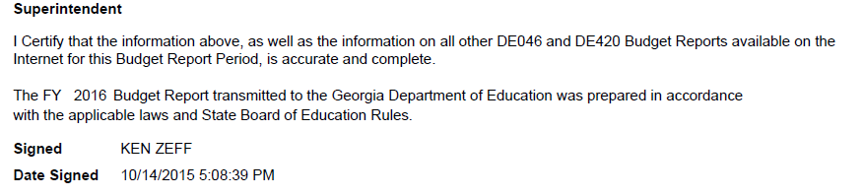
The DE46

Slide 102

We’re Done!
Questions?
Carmen Hernández-Freemire
Director Budget Services
470-254-6762 ph | 470-254-1240 fax
FreemireC@fultonschools.org

